Slide 1


Introduction to Virtual DOM in React Native
React Native has revolutionized mobile development with over 100 million downloads in 2024. Its architecture powers apps like Facebook, Instagram, and Airbnb.
Today we'll explore the Virtual DOM, a core concept that drives React Native's performance.

Slide 2

What is the Virtual DOM?
Lightweight JavaScript
Mirror of Real DOM
A memory-efficient JavaScript representation of your app's user interface.
Creates a virtual copy of the actual UI that can be manipulated faster.
React Innovation
First proposed by the React team in 2013 to solve UI performance challenges.

Slide 3




Why Virtual DOM? The Problem with Native DOM Updates
Slow Native Updates
Direct UI manipulation is resource-intensive and inefficient.
Performance Bottlenecks
Manipulating real DOM elements creates lag in user experience.
Real-World Impact
Large lists in traditional mobile apps can lag up to 300ms.

Slide 4
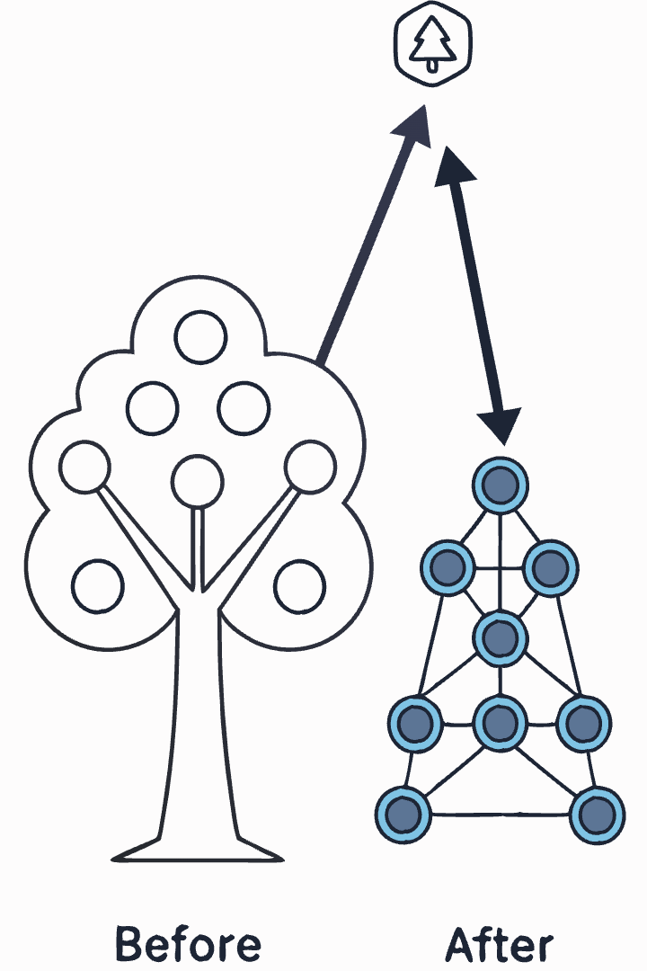
How the Virtual DOM Works in React Native
Create Virtual Representation
React builds a lightweight JavaScript copy of the UI in memory.
Diff Changes
When state changes, React compares old and new Virtual DOMs.
Update Only What Changed
Only the different elements are committed to the native UI.

Slide 5
Benefits of Using Virtual DOM
1
Enhanced Performance
2
Predictable States
Reduces direct native UI manipulation, accelerating rendering by up to 60%. This speed boost is vital for mobile devices with limited resources.
Supports a declarative UI paradigm, making state management in complex interfaces more straightforward. Developers can confidently anticipate UI behavior after changes.
3
Cross-Platform Consistency
4
Developer Experience
Delivers uniform interface behavior on both iOS and Android, minimizing bugs and creating a seamless user experience.
Streamlines debugging and offers better control over component lifecycles, making development and maintenance simpler and more efficient.

Slide 6

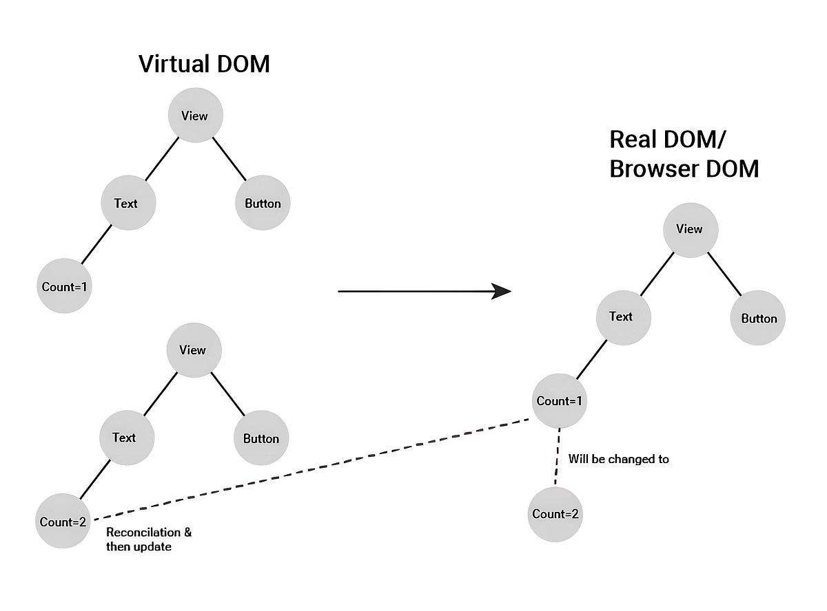
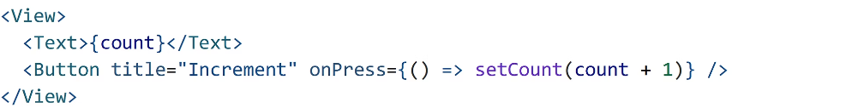
Virtual DOM in Action: Example Code
Suppose you have created a simple counter in React Native using a <View> as the container, a <Text> component to display the current count, and a <Button> that increments the count when selected. When you click the button, the setCount function updates the count state, causing the component to re-render and display the new count value in the <Text> component. This process creates an interactive interface where the displayed number increases each time you select the button.
Now, let's create a virtual DOM for the above code. Suppose the count variable currently has a value of "1." When the user clicks the button, it will increment the value of the count by "2." This change will be compared with the previous version of the virtual DOM, and then the necessary updates will be applied to the real DOM.

Slide 7




Conclusion & Key Takeaways
Superior Performance
Code Efficiency
Solid Foundation
Powers smooth, native-feeling applications
Enables high-quality apps with less code
Supports scalable, maintainable mobile UIs

